Slide 1
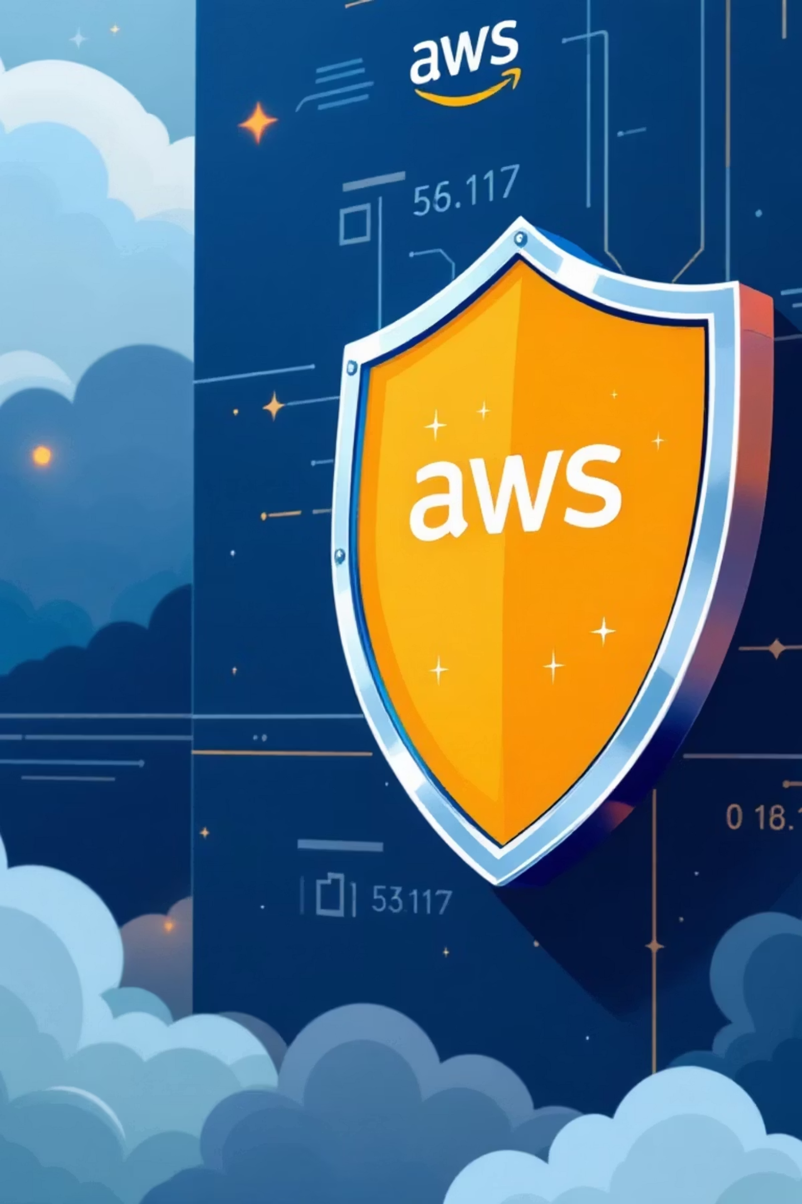
AWS IAM: Managing Cloud Security

Slide 2




LEARNING OBJECTIVES
What You'll Master Today
IAM Fundamentals
Core Components
Understand what AWS IAM is and why it's critical for cloud security in production environments
Create and manage users, groups, roles, and policies with confidence and precision
Authentication vs Authorisation
Industry Best Practices
Distinguish between who you are and what you're allowed to do in AWS
Follow IAM best practices essential for interviews and real-world projects

Slide 3


The Shared Responsibility Model
Why Cloud Security Matters
In cloud computing, security is a shared responsibility between AWS and the customer. AWS secures the cloud infrastructure itself, whilst you secure what you put inside the cloud.
AWS secures the cloud. You secure what's in the cloud.
AWS Responsibility
Customer Responsibility
Physical data centres
User management
Hardware infrastructure
Permissions and policies
Network security
Data access controls
OS and application security

Slide 4



FOUNDATION
What is AWS IAM?
AWS Identity and Access Management (IAM) is a service that helps you manage who can access what in your AWS environment. It's the security backbone of every AWS deployment.
01
Authentication
Verifying identity — who are you?
02
Authorisation
Defining permissions — what are you allowed to do?
Key Facts: IAM is a global service (not region-specific), completely free of cost, and enabled by default in every AWS account.

Slide 5


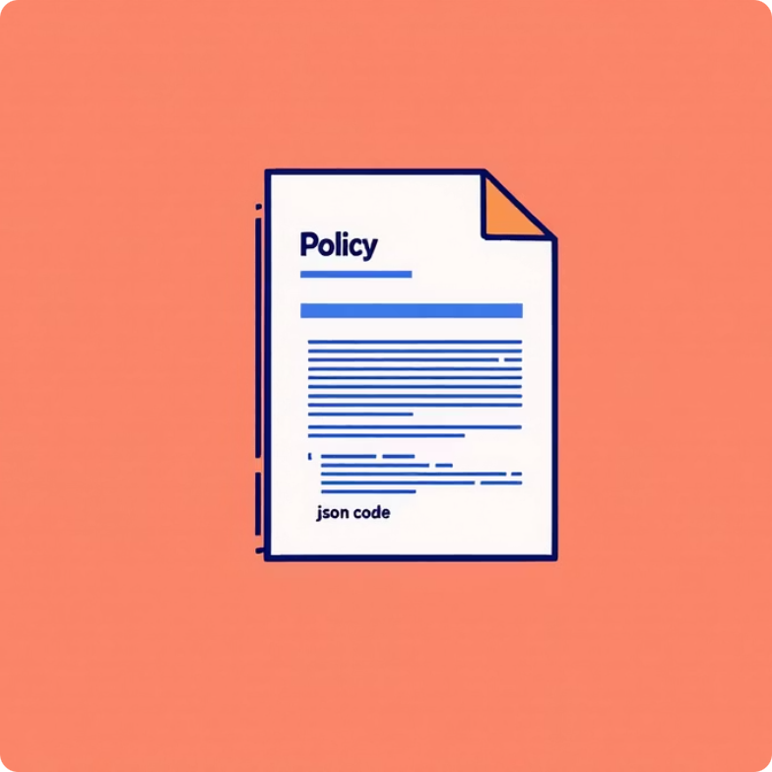

Core IAM Components
Understanding these four elements is essential for managing AWS security effectively.
IAM User
IAM Group
IAM Policy
IAM Role
A collection of users who inherit the same permissions. Examples include AdminGroup, DeveloperGroup, and ReadOnlyGroup.
A JSON document defining permissions with Effect, Action, Resource, and optional Conditions.
An identity with permissions but no permanent credentials, used by AWS services like EC2, Lambda, and ECS.

Slide 6

TECHNICAL DEEP DIVE
IAM Policy Structure
Anatomy of a Policy
Example Policy
Policies are JSON documents that define permissions. Each element serves a specific purpose in determining access control.
{
"Version": "2012-10-17",
"Statement": [
{
"Effect": "Allow",
"Action": "s3:ListBucket",
"Resource": "*"
}
]
}
Effect
Allow or Deny the action
Action
Which AWS operation is permitted
Resource
This policy grants permission to list all S3 buckets in the account.
On which AWS resource
Condition
Optional constraints (IP, MFA, time)

Slide 7

IAM Authentication Methods
Method
Used For
Password
AWS Management Console access
Access Keys
CLI, SDK, and programmatic access
Roles
AWS services and cross-account access
MFA
Additional security layer (highly recommended)
Security Priority: Multi-Factor Authentication (MFA) is highly recommended for root users and all administrative accounts to add an extra layer of protection.

Slide 8

CRITICAL
Root User: Handle With Care
Root User Capabilities
Best Practices
The root user has complete, unrestricted access to everything in your AWS account.
Use Root User ONLY For
Initial account setup
Full Powers
Billing configuration
Enabling MFA
Close AWS account
Change billing settings
Never Use Root User For
Enable and manage MFA
Access all services and resources
Daily operations, development work, or routine administrative tasks
Using the root user for daily operations is one of the most common security mistakes in cloud environments.

Slide 9

IAM Best Practices
Following these guidelines is essential for interviews and real-world cloud security.
Enable MFA
Least Privilege
Add multi-factor authentication for all privileged accounts
Grant only permissions needed for the job
Use Roles
Prefer IAM roles over access keys for services
Rotate Credentials
No Hardcoding
Regularly update passwords and access keys
Never embed credentials in code or configuration files
Use Groups
Manage permissions via groups, not individual users

Slide 10





Practical Application
Real-World Scenario
Hands-On Lab Work
A company has 10 developers and 2 administrators. Here's the secure approach using IAM best practices:
1
Create an IAM user in your AWS account with console access
Create Groups
2
Create a group and attach a managed policy like ReadOnlyAccess
Set up DeveloperGroup and AdminGroup with appropriate permission boundaries
Attach Policies
3
Enable MFA on your account using a virtual MFA device
Apply appropriate managed or custom policies to each group based on job functions
4
Explore IAM roles and create a role for EC2 instance access
Add Users
5
Review IAM Access Analyzer to identify unintended access
Create individual IAM users and assign them to their respective groups
Enable Security
Enforce MFA and password policies across all users
Result: Easy management, enhanced security, and scalable architecture that grows with your team.

